Slide 1

Project Title :-
Music Recommendation Using Facial Expressions
Presented By :-
Aadish Bhat (191203011)
Archit Gupta (191203079)
Ansh Khajuria(191203009)
Saksham Mahajan(191203063)

Slide 2
Abstract
Our proposed system tends to reduce the computational time involved in obtaining the results and the overall cost of the designed system, thereby increasing the system’s overall accuracy. Facial expressions are captured using an inbuilt camera. Feature extraction is performed on input face images to detect emotions such as happy, angry, sad, surprise, and neutral. Automatically music playlist is generated by identifying the current emotion of the user. It yields better performance in terms of computational time, as compared to the algorithm in the existing literature.

Slide 3
Problem Statement
Develop a system that presents a cross-platform music player, which recommends music based on the real-time mood of the user through a web camera using Machine Learning Algorithms.

Slide 4
Technology Stack
Python
Deep Face
Matplotlib
OpenCV
Spotify API

Slide 5
Your Solution
The proposed system benefits us to present interaction between the user and the music player. The purpose of the system is to capture the face properly with the camera. Captured images are fed into the Convolutional Neural Network which predicts the emotion. Then emotion derived from the captured image is used to get a playlist of songs. The main aim of our proposed system is to provide a music playlist automatically to change the user's moods, which can be happy, sad, natural, or surprised. The proposed system detects the emotions, if the topic features a negative emotion , then a selected playlist is going to be presented that contains the foremost suitable sorts of music that will enhance the mood of the person positively.

Slide 6
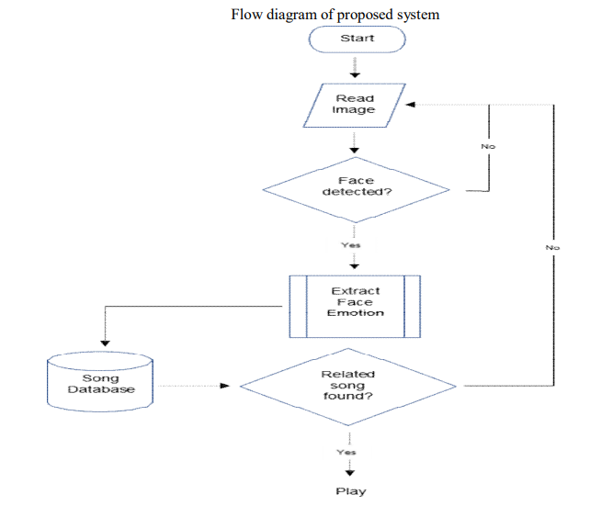
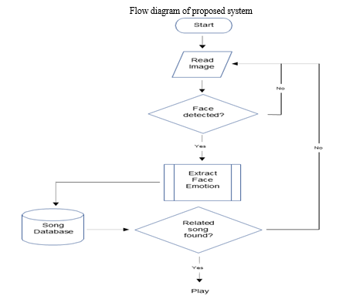
Flow Chart :-

Slide 7
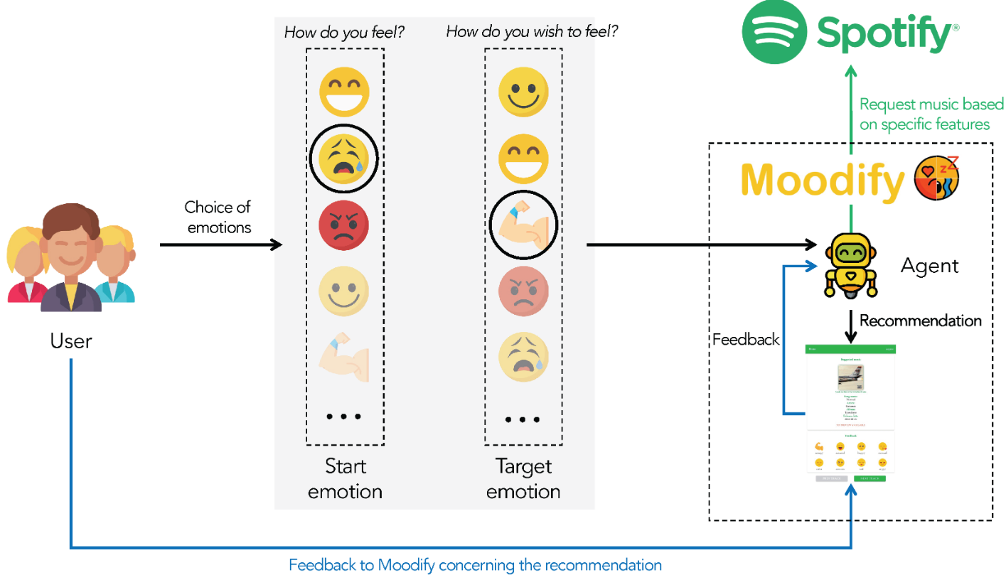

Slide 8
Benefits
The Facial Expression-Based Music Recommendation System offers numerous benefits to the user, including a more personalized music listening experience, improved emotional regulation, and increased engagement with music.
By providing music that is tailored to the user's emotional state, this system can also help reduce stress and anxiety levels.

Slide 9
Conclusion
The Facial Expression-Based Music Recommendation System is a groundbreaking technology that has the potential to revolutionize the way we listen to music and interact with technology.
By utilizing facial recognition software and a sophisticated music recommendation algorithm, this system provides a truly personalized music listening experience that is tailored to the user's emotional state.

Slide 10


